Slide 1
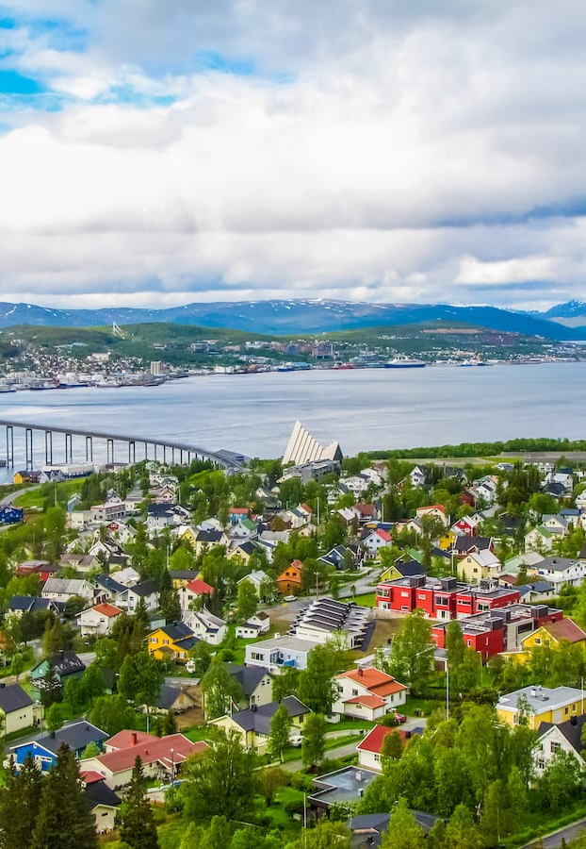

A long story about short-form adjectives in Russian and their rivals
Tore Nesset and Laura A. Janda
Dept. of Language and Culture
CLEAR research group
tore.nesset@uit.no, https://uit.no/ansatte/tore.nesset
laura.janda@uit.no , https://uit.no/ansatte/laura.janda
https://site.uit.no/clear/

Slide 2
Short-form adjectives and their rivals
- copula:
Short-form vs. long-form
+ copula:
Short-form vs. long-form vs. INS
Критерии очень простые_{LF}. ‘The criteria are very simple.’
Критерии очень просты_{SF}, и их всего два. ‘The criteria are very simple, and there are only two of them.’
Город был пуст_{SF}: талибы оставили его накануне ночью. ‘The town was empty: the Taliban warriors had left it just before that at night.’
Прилавки были пустые_{LF}, но голодато не было никакого […]. ‘The stalls were empty, but there was no hunger at all […].’
Фойе гостиницы тоже было пустым_{INS} […]. ‘The hotel foyer was also empty […].’
Two contexts
(-/+ copula) are analyzed in two articles

Slide 3
Some context
Other grammatical distinctions are usually named in terms of the concepts that they invoke: person, number, tense, aspect, voice, etc. By contrast, what is named is the form used to mark a distinction, leaving its meaning unclear.
We tend to think of long form as the default form for adjectives, and the short form as something that is marginal, perhaps even losing ground historically.

Slide 4
Tore Nesset & Laura A. Janda (2023): The long and the short of it: Russian predicate adjectives with zero copula. Russian Linguistics https://doi.org/10.1007/s11185-023-09280-1 (open access!)
NB! Only -copula in this article (we look at +copula and competition with INS in 2025)

Slide 5
A classic problem in Russian morphosyntax
Choice between long forms (LF) and short forms (SF) of predicate adjectives
Predicate adjectives = adjectives in predicate position, the Y in sentences meaning ‘X = Y’, as in Иван добрый/добр
Predicate adjectives occur in sentences with full verbs (e.g., verbs of motion) or copula verbs (e.g., быть ‘be’ and стать ‘become’)
A copula verb may be overt (e.g., был ‘was (masculine singular)’ or covert (so-called zero copula)
We limit ourselves to sentences with zero copula, where the choice is between nominative long forms (LF) and short forms (SF)
(In sentences with overt verbs, the predicative adjective may also occur in the instrumental)

Slide 6
Corpus examples with the adjective prostoj ‘simple’
(1) a. Критерии очень простые_{LF}.
‘The criteria are very simple.’
b. Критерии очень просты_{SF}, и их всего два. ‘The criteria are very simple, and there are only two of them.’
(2) a. Ответ простой_{LF}: в обеспечении интеллектуальных сверхвозможностей важнейшую роль играет активация определенных, а вероятно, и многих мозговых структур.
‘The answer is simple: for intellectual superopportunities the activation of certain and, presumably, numerous brain structures play a major role.’
b. Ответ прост_{SF}: здания-памятники расположены на самых коммерчески привлекательных территориях города.
‘The answer is simple: the historic buildings are situated in the commercially most attractive parts of town.’

Slide 7

Method and data
Establish a database of examples culled from the Russian National Corpus (syntactic subcorpus): 5,813 example sentences
Identify (nearly) categorical rules whereby the choice of form is determined by the context
Lexical: adjectives that accept only one form (рад etc.)
Morphosyntactic: constructions that accept only one form
Pinpoint a “space of competition”, i.e., a set of contexts where all forms are possible
Analyze statistically the interplay of contextual factors within the space of competition.
Possible outcomes
Predictable from context
NOT predictable from context – may have different meanings, but we may also not have identified the correct contextual factors

Slide 8
Relevant factors (from scholarly literature)
Word-order:
SA: Subj before Adj
AS: Adj before Subj
Word order:
SA: Subj before Adj
AS: Adj before Subj
Subject + Ø + Adjective (+ complement)
Море + Ø + богато + рыбой.
Noun
Personal pronoun
Other pronoun
Infinitive
Clause
No subject
Gender/number
Frequency
YES vs. NO
Relevant factors relate to the subject, the predicate, and the relation between them.

Slide 9
Noise in the data
We had to eliminate many adjectives that don’t have both LF and SF:
numerals (один, первый…)
pronouns with adjectival declension (чей, другой, этот, иной, какой, мой, наш, сам, весь…)
Past Active Participles (бывший, сумасшедший…)
adjectives that have only SF (должен, рад)
adjectives that have only LF (американский, немецкий, отсталый, загорелый, лучший, меньший, дармовой, кадровый, мировой, пирров...)
superlatives with самый + LF

Slide 10
Types of Complement (part one)
(3) Я, конечно, виновата_{SF}, что не пошла в партизаны.
‘I am, of course, guilty for not becoming a partisan.’
(4) Она способна_{SF} выражать эмоции.
‘She is able to express emotions.’
(5) Они не согласны_{SF} со сроком.
‘They don’t agree on the deadline.’
(6) Описание Марко Поло полны_{SF} неточностей. ‘Marco Polo’s descriptions are full of inexactitudes.’
FINITE CLAUSE
INFINITIVE CONSTRUCTION
PREPOSITIONAL PHRASE
GENITIVE NOUN PHRASE

Slide 11
Types of Complement (part two)
(7) Я очень благодарна_{SF} Валдимиру Шварцману и
Саше Чачко за искренее желание помочь.
‘I am very grateful to Vladimir Švarcman and Saša Čačko
for their sincere wish to help.’
(8) Чем он так горд_{SF}?
‘What is he so proud of?’
DATIVE NOUN PHRASE
INSTRUMENTAL NOUN PHRASE
SF in over 99% of examples with complements

Slide 12
(Nearly) categorical rules
Adjective with complement → SF
(5 exceptions out of 809 examples, coverage ≈ 99%)
Impersonal constructions → SF (Infinitive, clausal or no subject, neuter adj) (19 exceptions out of 1,710 examples, coverage ≈ 99%)
Non-personal pronoun as subject → SF (это ‘this’, to ‘that’, всë ‘all’ etc.) (13 exceptions out of 325, coverage ≈ 96%)
Word-order (rhematic subject): AS → SF (10 exceptions out of 429 examples, coverage ≈ 98%)
Let’s take a closer look: Is there a common denominator?
All (nearly) categorical rules involve SF.
No morphosyntactic contexts where LF is the only option!

Slide 13
Descriptions of situations vs. participants
Найти заинтересованного капиталиста практически невозможно_{SF}. ‘Finding an interested capitalist is practically impossible.’
Что это не зеркало – точно_{SF}, потому что [...]. ‘That this is not a mirror is clear, because [...].’
Каждый актер привнес в фильм свою неподражаемую ауру: Светлана Немоляева, Лия Ахеджакова, Людмила Иванова ... Как ими можно не восхищаться и не любить? Это невозможно_{SF}! ‘Each actor contributed their inimitable aura to the movie: S. N., L. A., L. I. ... How is it possible not to be excited about them and not to love them? It’s impossible!’
Это место не узнать: оно золотое_{LF}, а за ним совершенно чёрная река. ‘This place is unrecognizable: it is golden, and behind it there is a completely black river.’
SF describes situation
SF describes situation
SF describes situation
LF describes participant
Sentences 1–2 are traditionally analyzed as ADVERBS. However, same ending –o.
Revised (nearly) categorical rule:
Predicate adjective describes situation → SF

Slide 14
Word order
Thematic word order = SA = subject before predicate adjective
See all previous examples
Rhematic word order = AS = predicate adjective before subject
Известно_{SF} имя его отца – Рейнер Фос. ‘The name of his father is well known – Reiner Foss.’
SF in over 97% of examples AS word order

Slide 15
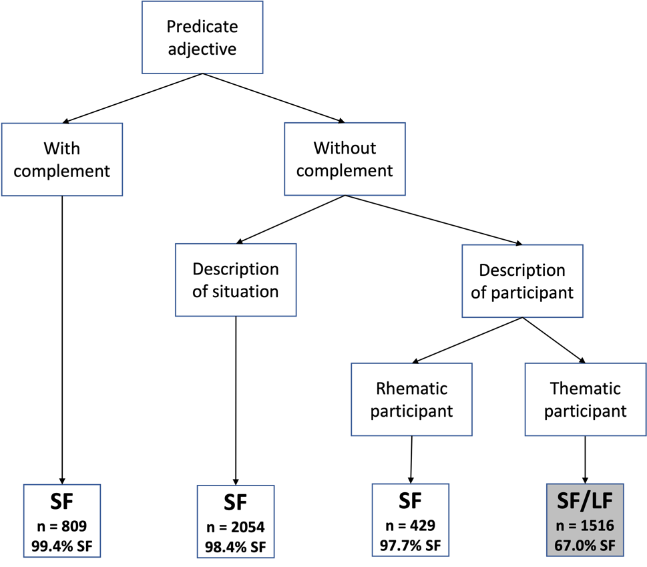
Overview – decision tree
The situation/Participant Hypothesis
“In sentences without a complement
Long forms are descriptions of thematic participants.
Short forms are descriptions of situations or participants.”
“Space of competition”:
Even here SF is dominant!
Next step: Statistical analysis of “space of competition”

Slide 16
Other factors in the space of competition
Type of subject
Gender and number
Frequency of adjective overall and frequency of adjective as predicate

Slide 17
Type of subject
Non-personal pronouns Это, Всё
Noun phrases unmodified
Noun phrases modified
Personal pronouns
No subject
Other subject

Slide 18
Statistical analysis focuses only on the “space of competition” between SF and LF
Predicate adjectives
Without a complement
That describe a participant (not a situation)
The participant is thematic (appears before the adjective)
The dataset contains 1516 such examples
67% of them use SF

Slide 19
Statistical analysis
Adjective_form ~ 1 + Log_Frequency_predicative + Subject + Gender_Number_adj
Our model yields correct predictions in 70.05% of all cases. While this is not a lot better than the baseline of 67.02%, a statistical comparison of our model with the baseline shows that the difference is highly significant and the probability that this difference (or a greater one) could occur by chance is 0.006. The C-score measure of goodness of fit is 0.704, which indicates a good model. The R-squared value indicates that the model accounts for 16.5% of the variance in the data.

Slide 20
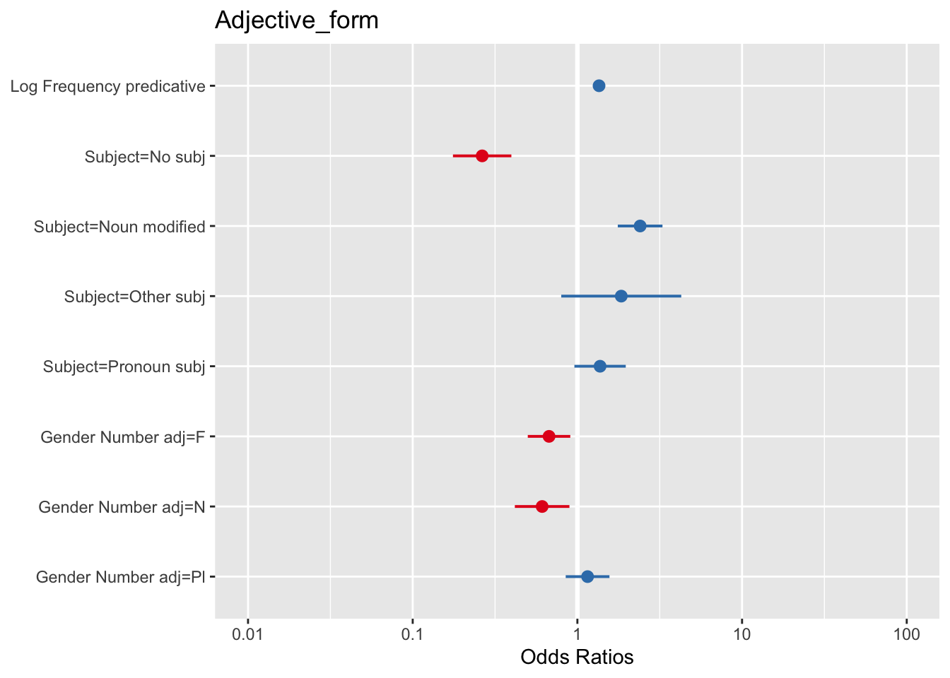
Statistical analysis
Adjective_form ~ 1 + Log_Frequency_predicative + Subject + Gender_Number_adj
We now turn to analysis of individual factors

Slide 21
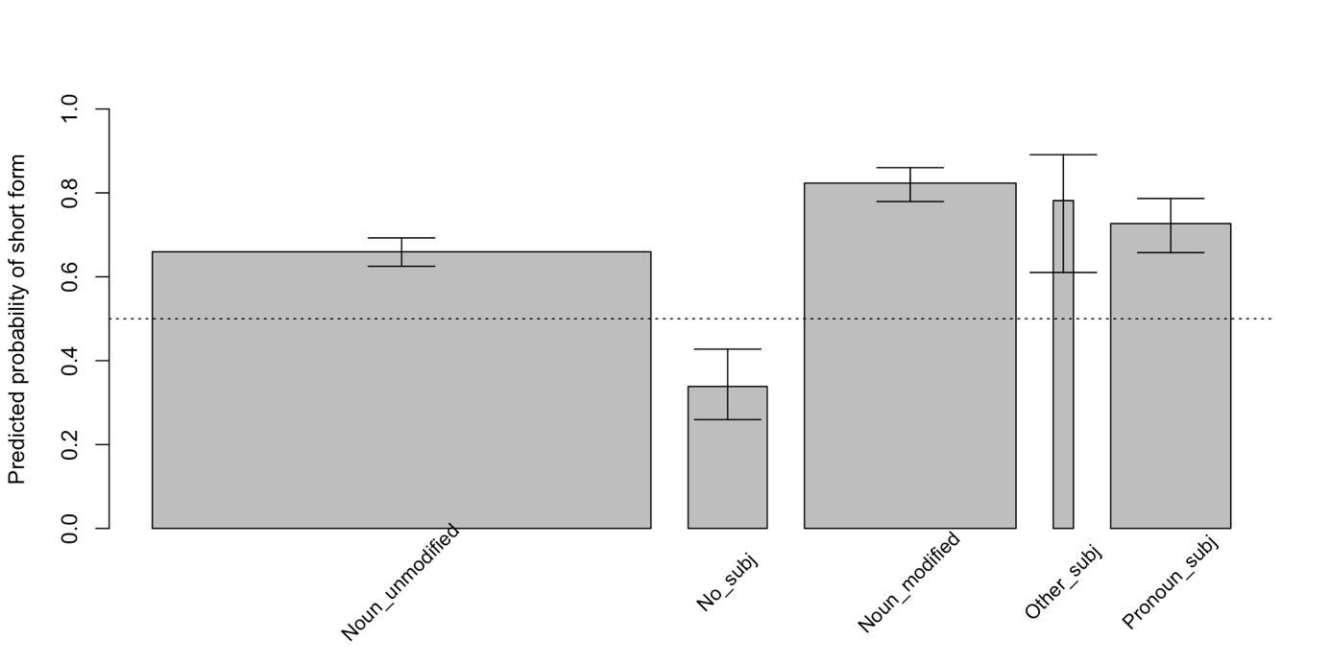
Subject types
Thicker columns = more data
Elliptic sentences without subject favor LF!

Slide 22
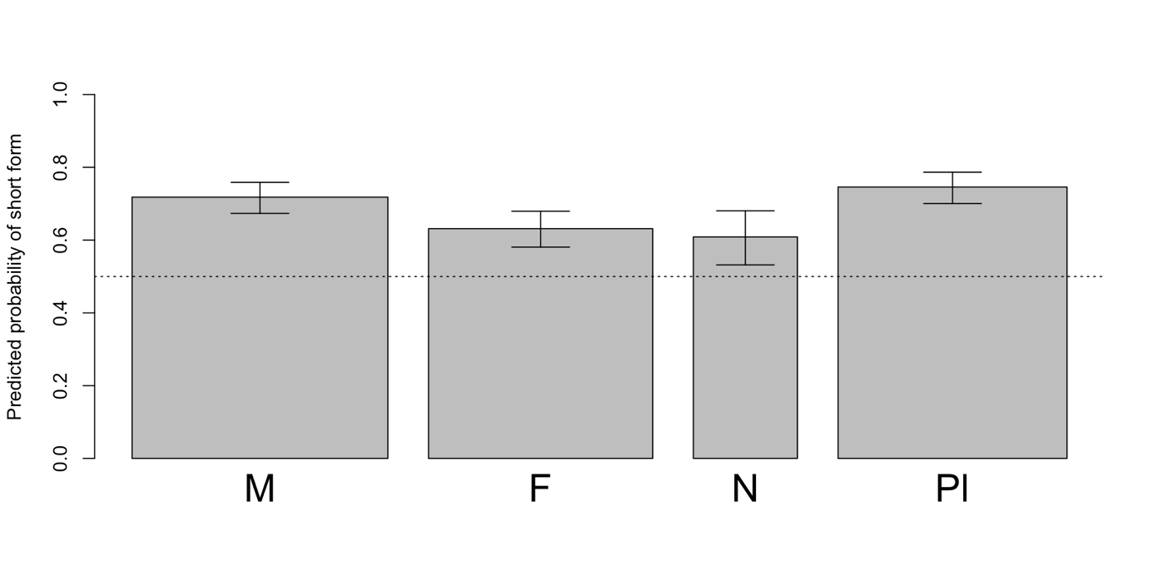
Gender and number
But differences are rather small!
The gender/number hierarchy:
Masculine singular, plural > feminine singular, neuter singular (where > means “is more likely to combine with an SF than”)

Slide 23
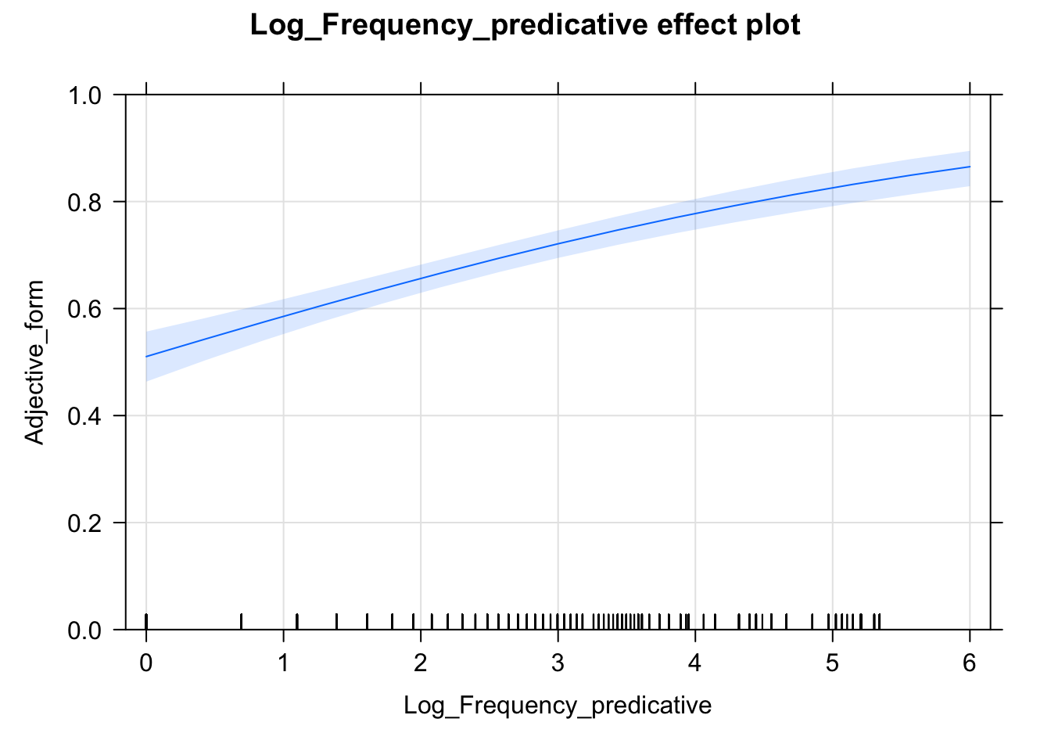
Frequency
Higher frequency yields higher likelihood of SF.

Slide 24
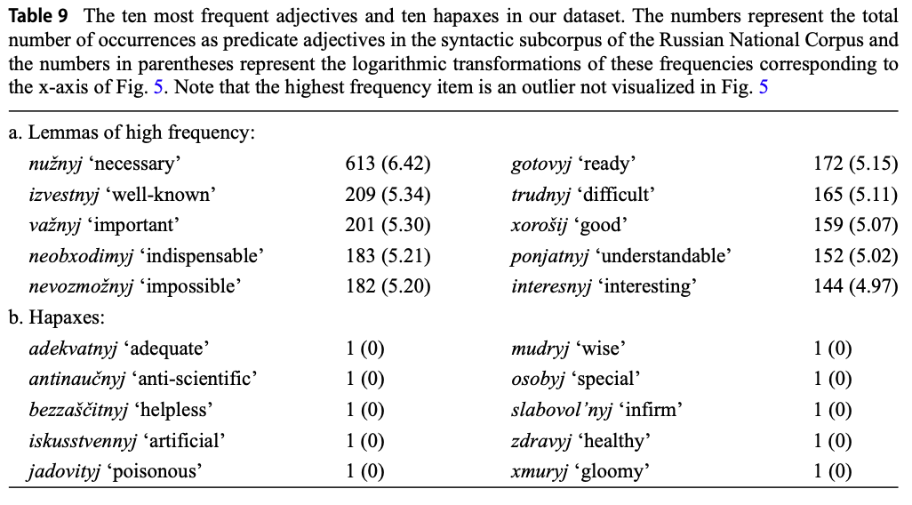

Slide 25
Interim summary – Ø copula
These findings are compatible with a situation where LF and SF convey different meanings (since the choice is not completely determined by the context).
Most frequent option: SF
(Nearly) categorical rules:
Adjective with complement → SF
Impersonal constructions → SF
Non-personal pronoun as subject → SF
Word-order: AS → SF
The Situation/Participant Hypothesis:
“In sentences without a complement
Long forms are descriptions of thematic participants.
Short forms are descriptions of situations or participants.”
Factors favoring SF:
Overt subject
Masc sg or pl
High frequency
Relatively free variation inside “space of competition”

Slide 26
What we did not look at
Variation in meaning expressed by LF vs. SF
SF = state “contingent and potentially variable” (Timberlake 2004: 292)?
Stylistic and sociolinguistic factors
SF more bookish?
Change over time
SF decreasing?
These are good topics for future research!

Slide 27
Conclusion: Towards a methodology for the study of rival forms
Create a database of corpus examples
Pinpoint (nearly) categorical rules
Identify the “space of competition”
Carry out statistical analysis of the “space of competion”
Clarify to what extent the choice of form is predictable from context
To the extent that the choice is NOT predictable from context, the forms may have different meanings, ...
... but we may also not have identified the correct contextual factors.
This methodology sheds new light on agreement with predicate adjectives.

Slide 28
Tore Nesset & Laura A. Janda (2025): Contextually determined or semantically distinct? The competition between instrumental, long form nominative and short form nominative in Russian predicate adjectives https://doi.org/10.1007/s11185-025-09314-w (open access!)
Here we look at examples with copula and competition with INS

Slide 29
Instrumental (INS), long form (LF), short form (SF) with copular verb (быть)
Фойе гостиницы тоже было пустым_{INS} […].
‘The hotel foyer was also empty […].’
Прилавки были пустые_{LF}, но голодато не было никакого […].
‘The stalls were empty, but there was no hunger at all […].’
Город был пуст_{SF}: талибы оставили его накануне ночью.
‘The town was empty: the Taliban warriors had left it just before that at night.’
Possible factors: form of the copula verb, subject, word order, complements to the predicate adjective, meaning

Slide 30
Steps in the method
Collected database of examples with overt copula from Russian National Corpus (syntactic subcorpus)
Identified (nearly) categorical rules and narrowed focus to space of competition
Statistical analysis of examples in the space of competition (1690 examples)

Slide 31
Findings
Choice of adjective form is partly determined by 3 factors of context:
presence/absence of a complement
nature of subject
mood of copula verb
4 (nearly) categorical rules: one requires INS (very restricted), 3 require SF
SF is default option for predicate adjectives in almost all contexts
LF is weakest, least frequent
In contexts where INS, SF, LF are possible, they have different meanings
SF marks temporary states rather than permanent characteristics

Slide 32
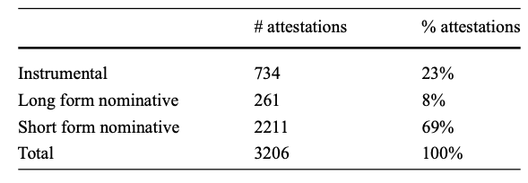
Data
Sentences with forms of быть (except есть) and predicate adjective
Removed all adjectives that do not have both short and long forms, e.g., those in –ский and рад (see list from 2023 article).

Slide 33
Factors
Complement of adjective: finite clause, infinitive clause, noun phrase, prepositional phrase, no complement (see next slide)
Subject: finite clause, infinitive clause, modified noun, unmodified noun, pronoun, other overt subject, no subject
Word order: adjective initial, medial, final
Gender and number of adjective: masculine singular, feminine singular, neuter singular, plural
Frequency of lemma overall and frequency as predicate adjective
Lemma of each adjective
Form of copula verb: finite past, finite future, imperative, subjunctive, infinitive, gerund

Slide 34
Complement of adjective
Finite clause
Втайне я был даже слегка горд_{SF}, что он готов опять слушать
‘Secretly I was even a little proud that he was ready to listen again’
Но машины были готовы_{SF} уехать.
‘But the cars were ready to leave’
Мы были довольны_{SF} своей новой квартирой.
‘We were satisfied with our new apartment’
Он всю жизнь был особо чувствителен_{SF} к запахам.
‘All his life he was particularly sensitive to smell’
Also: No complement
Infinitive clause
Noun phrase
Prepositional phrase

Slide 35
Subject
Infinitive clause
По улицам ходить было небезопасно_{SF}, ни днем, ни ночью.
‘To walk in the streets was not without danger, both day and night.’
Особенно было обидно_{SF}, что он был мокрый.
‘In particular it was a shame that he had been wet.’
Finite clause
Other types of subjects: modified noun, unmodified noun, pronoun, other overt subject, no subject

Slide 36
Form of copula
finite past
был, была, было, были
finite future
буду, будешь, будет, будем, будете, будут
imperative
будь, будьте
subjunctive
был бы, была бы, было бы, были бы
infinitive
быть
gerund
будучи

Slide 37
(Nearly) categorical rules
Gerund as copula: instrumental
Adjective with complement: short form
Clausal or infinitival subject: short form
Impersonal constructions with no subject: short form
Non-personal neuter pronouns as subjects: short form
We will go through each in more detail

Slide 38
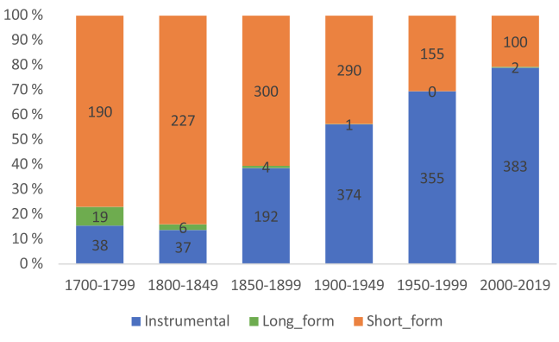
Gerund as copula: instrumental
Но будучи независимым_{INS}, он не нуждался в этом и работал самостоятельно.
‘But since he was independent, he didn’t need this and worked on his own.’
In our data: 16 ехх. with gerunds in our data, all INS
Historical trend for predicate adjectives immediately following будучи: Data from Russian National Corpus

Slide 39
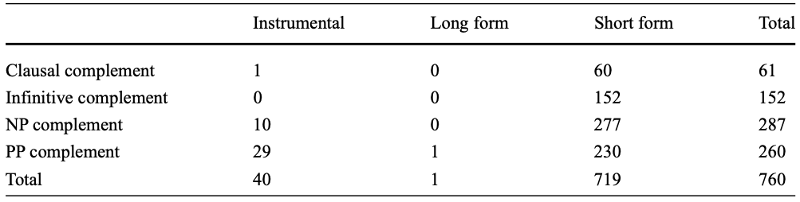
Adjective with complement: short form
Mostly involves для, as in this example:
Важно, что кредит будет доступным_{INS} для предприятий.
‘It is important that credit will be available for companies.’

Slide 40
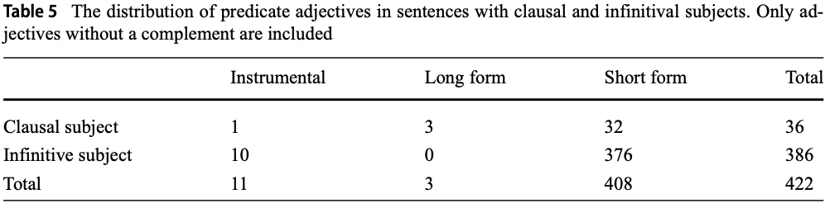
Clausal or infinitival subject: short form

Slide 41
Impersonal constructions with no subject: short form
Здесь, в зоопарке, было чудесно_{SF} и совсем не страшно_{SF}.
‘Here, in the zoo, it was wonderful and there was nothing to be afraid of.’
All 121 examples of impersonal constructions with no overt subject in our dataset have short form.

Slide 42
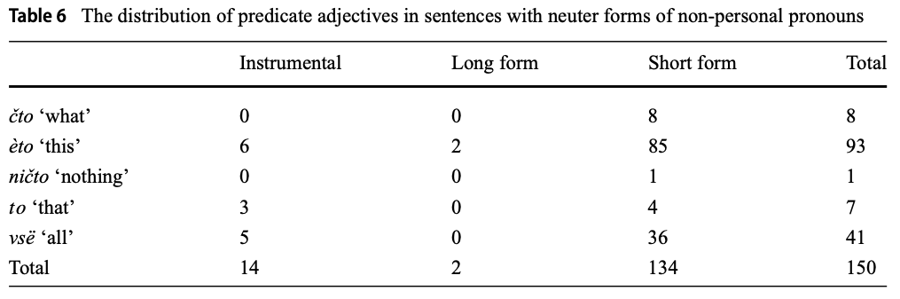
Non-personal neuter pronouns as subjects: short form
Всё было безуспешно_{SF}.
‘Everything was unsuccessful.’

Slide 43
Summary of (nearly) categorical rules
Gerund будучи -> INS
Complement -> SF
“Non-standard subjects” (clauses, infinitives, non-­personal pronouns, and zero subjects in impersonal sentences) -> SF
Note: non-standard subjects refer to events, standard subjects refer to participants
Non-standard subject это:
Умру-то – это ясно_{SF}, но не сейчас.
‘I am going to die – that is clear, but not now.’
Standard subject оно:
В избе всего одно окно и оно грязно_{SF}.
‘In the hut there is only one window, and it is dirty.’

Slide 44
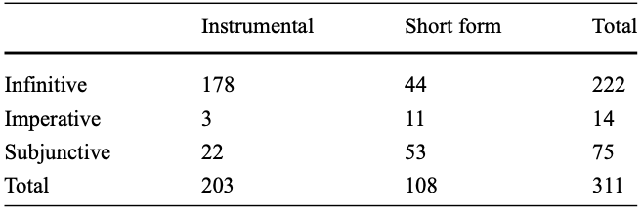
INS vs. SF in sentences with an infinitive, imperative, or subjunctive form of быть
INS in 65.2% of relevant examples
Adjective_form∼ Copula + (1|Lemma_adjective)

Slide 45
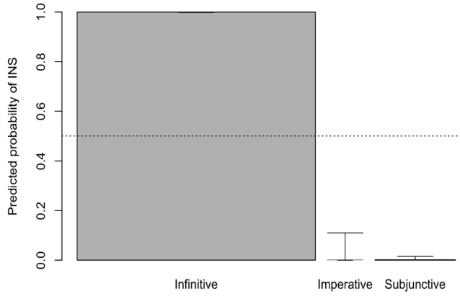
Effect of copula forms on prediction of instrumental forms of predicate adjectives

Slide 46
Typical patterns for infinitives, imperatives, subjunctives
Infinitive:
А для чего быть богатым_{INS}?
‘But what’s the point of being rich?’
Imperative
Не будь ревнив_{SF}, ответил Пилат и потер руки.
‘Don’t be jealous [...], Pilate answered and rubbed his hands.’
Subjunctive:
Однако успех «третьей колонны» был бы возможен_{SF} лишь при условии, если бы она была последовательно оппозиционной.
‘However, the success of the “third column” would only be possible under the condition
that the “third column” would be consistently oppositional […].’

Slide 47
Individual adjectives have their own preferences
Adjectives favoring INS: pročnyj ‘firm’, steril’nyj ‘sterile’, krepkij ‘strong’
Adjectives favoring SF: vidnyj ‘visible, prominent’, uznavaemyj ‘recognizable’, sostojatel’nyj ‘solvent’, raznoobraznyj ‘varied’, različnyj ‘heterogeneous’, ravnyj ‘equal’, produmannyj ‘well thought­-out’, primenimyj ‘applicable’, pravyj ‘right’, pravdivyj ‘true’, poxožij ‘similar’, ploxoj ‘bad’, otnositel’nyj ‘relative’, oskorbitel’nyj ‘offensive’, odetyj ‘dressed’, nepravil’nyj ‘incorrect’, negativnyj ‘negative’, grubyj ‘coarse’, demokratičnyj ‘democratic’, blagodarnyj ‘grateful’, uverennyj ‘convinced’, gotovyj ‘ready’, xorošij ‘good’, vrednyj ‘harmful’, slyšnyj ‘audible’, nepravyj ‘incorrect’
Note: many adjectives favoring SF are historically participles

Slide 48
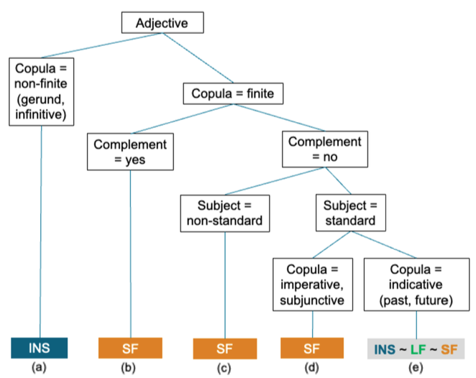
Decision tree for predicate adjective
The next step is to focus just on these 1690 examples
(“space of competition”):
27% INS
15% LF
58% SF

Slide 49
INS vs. LF vs. SF
Exclude all data pertaining to (nearly) categorical rules
1690 remaining examples have past and future forms of быть
Multinomial regression:
mlogit(formula= Adjective_form∼ 1 | Copula + Word_order + Subject + Gender_Number_adj + LogFrequency_predicative)
Copula: past, future
Word order: adjective initial, medial, final
Subject: modified noun, unmodified noun, pronoun, other overt subject, no subject
Gender and number of adjective: masculine singular, feminine singular, neuter singular, plural
Frequency
All factors are significant, but effects are not large and model does not cover a large amount of variance.
Following slides illustrate observed preferences.

Slide 50
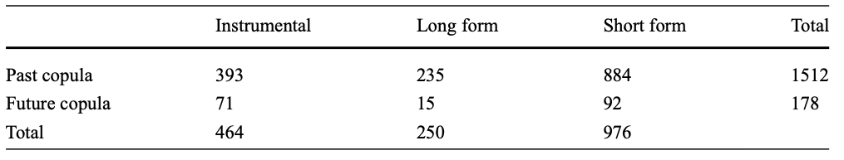
Copula= Past, Word_order= A_final, Subject= Noun_unmodified, Gender_Number_adj= Masculine, Frequency_predicative = 1 >> preference for INS
All further observations are comparisons
with this combination of factors
Фольклор всегда был устным_{INS}.
‘Folklore was always oral.’

Slide 51
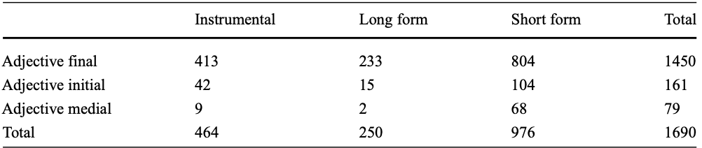
Medial placement of adjective >> SF
Трудно сказать, был ли счастлив_{SF} этот мрачноватый человек.
‘It was hard to tell, if this darkish person was happy or not.’

Slide 52
Subject is modified noun or pronoun, or no overt subject >> SF
Subject is modified noun:
Венецианская республика была очень богата_{SF}.
‘The Venetian republic was very rich […].’
Subject is pronoun:
Луну изучали не потому, что она была интересна_{SF}.
‘They didn’t study the moon because it was interesting.’
No overt subject:
Вообще, в своей жизни Ирина Васильевна никогда не пела – до того была робка_{SF} и тиха_{SF}.
‘In general, Irina Vasil’evna had never sung in her life – she was so timid and quiet.’

Slide 53
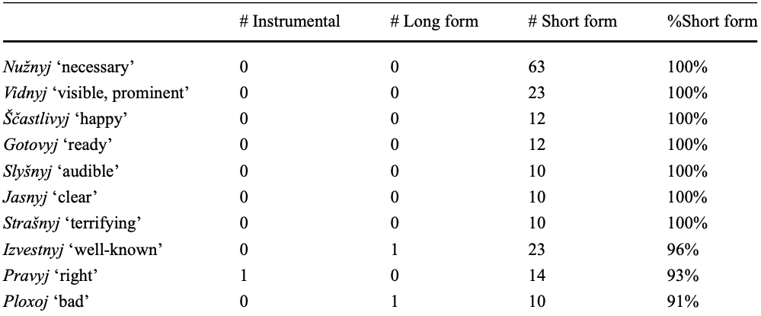
Individual preferences of high frequent adjectives
High frequency promotes SF

Slide 54
Summary for predicate adjectives with overt copula
Contexts conditioning the choice of adjective form:
Non-­finite copula yields the instrumental.
Copula marked for imperative or subjunctive mood yields the short form.
The presence of a complement yields the short form.
Non­-standard subject yields the short form.
There is competition between the instrumental, the long form nominative, and the short form nominative if the following three conditions are met:
a. The copula verb is in the indicative.
b. The predicate adjective does not combine with a complement.
c. The predicate adjective has a standard subject (a personal pronoun or a noun phrase).
Coherence with Situation/Participant Hypothesis?

Slide 55


Wrapping up
Empirical
Short forms are alive and kicking.
Partly determined by contextual factors.
In many cases, more than one form is possible – semantic differentiation?
Methodological
Pinpoint (nearly) categorical rules
Establish “space of competition”
Analyze this space by means of statistics
Ideas for future research Russian National Corpus now has (improved) syntactic annotation – possible to study more balanced data
Diachrony
Stylistics and sociolinguistic factors
Semantic differences

